Slide 1
Object/Image Recognition
Exploring
Convolutional Neural Network(s) (CNN)
MNIST Dataset Exploration
(dataset of images)

Slide 2
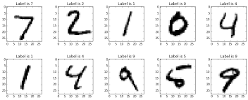
MNIST Dataset
Ref 1) The MNIST Database: http://yann.lecun.com/exdb/mnist/
The MNIST problem is a dataset developed by Yann LeCun, Corinna Cortes and Christopher Burges for evaluating machine learning models on the handwritten digit classification problem. See ref(1).
The dataset was constructed from a number of scanned document dataset available from the National Institute of Standards and Technology (NIST). This is where the name for the dataset comes from, as the Modified NIST or MNIST dataset.

Slide 3
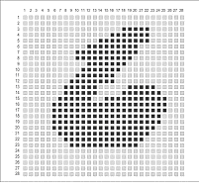
MNIST Dataset
Ref 1) The MNIST Database: http://yann.lecun.com/exdb/mnist/
Dataset of Images
Images of digits were taken from a variety of scanned documents, normalized in size and centered. This makes it an excellent dataset for evaluating models, allowing the developer to focus on the machine learning with very little data cleaning or preparation required.
Each image is a 28 by 28 pixel square (784 pixels total), see fig(1). A split of the dataset is used to evaluate and compare models, where 60,000 images are used to train a model and a separate set of 10,000 images are used to test it.
fig(1) - typical image of digit

Slide 4
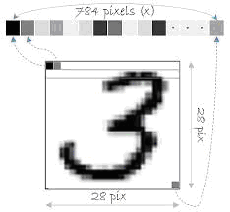
MNIST Dataset
Ref 1) The MNIST Database: http://yann.lecun.com/exdb/mnist/
The preparation of the data includes a "flattening" of the image. This means the 28x28 array of pixels are converted to a flat 1-D structure of 784 (28 * 28) raw pixel values, see fig(2).
The Training Dataset
The Training dataset has 60000 records/instances (1x784 size); each record representing one image
fig(2) 28x28 array converted into 1x784 array

Slide 5
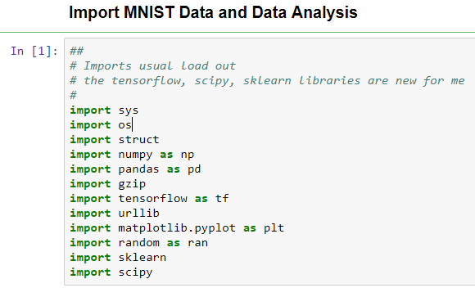
MNIST Dataset
Import MNIST Data and Data Analysis
Examining the Algorithm
Import of Python Libraries

Slide 6
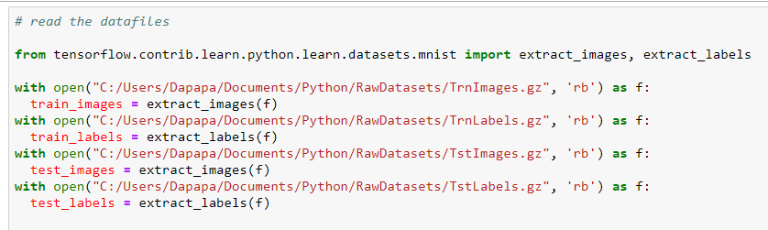
MNIST Dataset
Import MNIST Data and Data Analysis
Examining the Algorithm
# Reading data from web
urllib.request.urlretrieve("http://yann.lecun.com/exdb/mnist/train-images-idx3-ubyte.gz","C:/Users/Documents/Python/RawDatasets/TrnImages.gz")
urllib.request.urlretrieve("http://yann.lecun.com/exdb/mnist/train-labels-idx1-ubyte.gz","C:/Users/Documents/Python/RawDatasets/TrnLabels.gz")
urllib.request.urlretrieve("http://yann.lecun.com/exdb/mnist/t10k-images-idx3-ubyte.gz","C:/Users/Documents/Python/RawDatasets/TstImages.gz")
urllib.request.urlretrieve("http://yann.lecun.com/exdb/mnist/t10k-labels-idx1-ubyte.gz","C:/Users/Documents/Python/RawDatasets/TstLabels.gz")

Slide 7
MNIST Dataset
Ref 1) The MNIST Database: http://yann.lecun.com/exdb/mnist/
Import MNIST Data and Data Analysis
Examining the Algorithm
Null and Missing Values
It is assumed that the images do not have missing values as found at Ref(1)

Slide 8
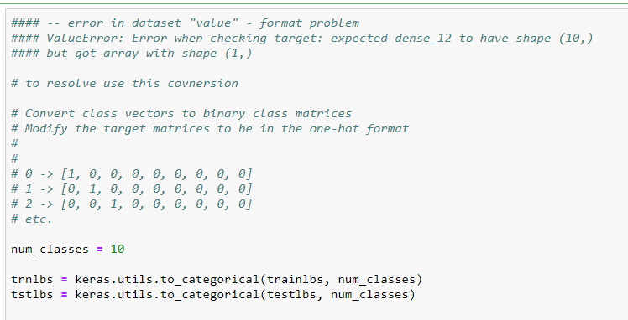
MNIST Dataset
Ref 1) The MNIST Database: http://yann.lecun.com/exdb/mnist/
Import MNIST Data and Data Analysis
Examining the Algorithm
Normalization (one-hot format)
A grayscale normalization was done to reduce the effect of illumination's differences.
Tech Note: CNN's converge more efficiently on [0..1] data than on [0..255]

Slide 9
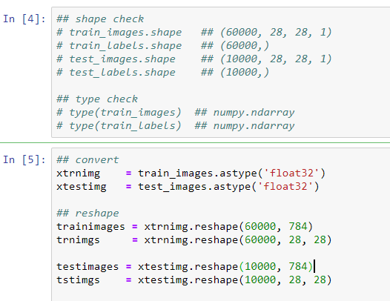
MNIST Dataset
Ref 1) The MNIST Database: http://yann.lecun.com/exdb/mnist/
Import MNIST Data and Data Analysis
Examining the Algorithm
Dataset Shape, Type and Reshape
Reshape
Keras requires an extra dimension in the end which
correspond to channels. MNIST images are gray scaled
so it use only one channel.
For RGB images, there is 3 channels;
reshaped 784px vectors to 28x28x3 3D matrices.

Slide 10
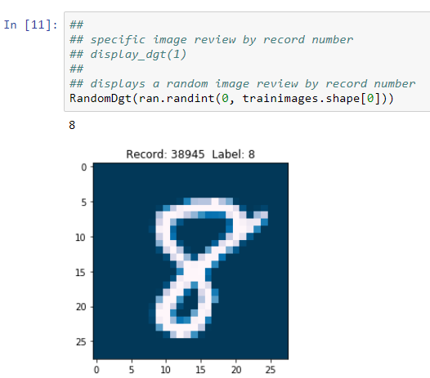
MNIST Dataset
Import MNIST Data and Data Analysis
Examining the Algorithm
Visual Check
A visual examination of the dataset helps to understand the formats; The illustration to the right is the result of a function that pulls one random record from the dataset; the record number, Label and the Image is shown.
** The Label should accurately describe the Image

